Slide 1
MACHINE LEARNING FOR SMARTER CROP PLANNING
Debasis Pani, Noah Sprenger, Sahithi Challapalli
Notes:
Noah: This project started with a question — what if we could take something as old as farming, and pair it with something as modern as data science?
Could a simple algorithm, like Naïve Bayes, help farmers predict which crops will thrive based on their soil and climate?
That’s what we set out to explore.

Slide 2

Introduction: The Global Challenge Feeding more people with fewer resources and greater uncertainty
Rising Food Demand Food demand could rise ~50% by 2050 as populations grow and diets shift.
Shrinking Farmland Cities and erosion remove millions of hectares of arable land each decade.
Declining Soil Health Intensive cultivation and synthetic fertilizer/herbicide dependence degrade fertility.
Growing Cyclical Climate Volatility Irregular weather patterns, including rainfall, global cooling, and heat waves, cut yields across regions.
Notes:
Noah: By 2050, the world will need about fifty percent more food.
But every year, we’re losing farmland to urban sprawl and erosion… and the soil we still have is getting weaker.
And then, there’s the climate.
Longer droughts. Heavier rain.
Yields that swing harder than ever before.
The margin for error in farming is shrinking fast…
and every decision now matters more than it ever has.

Slide 3

Motivation: Doing More with Less The challenge isn’t just to grow, it’s to grow smarter, more sustainably.
More Output, Fewer Resources Farmers must increase yields using less land, water, and fertilizer
Two Divergent paths:
Heavy synthetic inputs (fast, but destructive)
Data Guided Adaptation, working with the land
Data as Leverage:
Affordable soil & weather sensors now offer unprecedented data access
Models must stay simple, interpretable, and accessible
i.e. not compute-intensive, cloud-reliant
Our goal: Show how even a simple model like Naïve Bayes can turn these data into actionable, sustainable insight
Notes:
Noah: The challenge isn’t just producing more food, it’s producing it smarter.
Farmers everywhere are being asked to yield more with fewer resources.
We can either keep forcing the land with chemicals… or start listening to what the data tells us.
Our motivation was to see how even the simplest model, Naïve Bayes, could make that insight real.

Slide 4

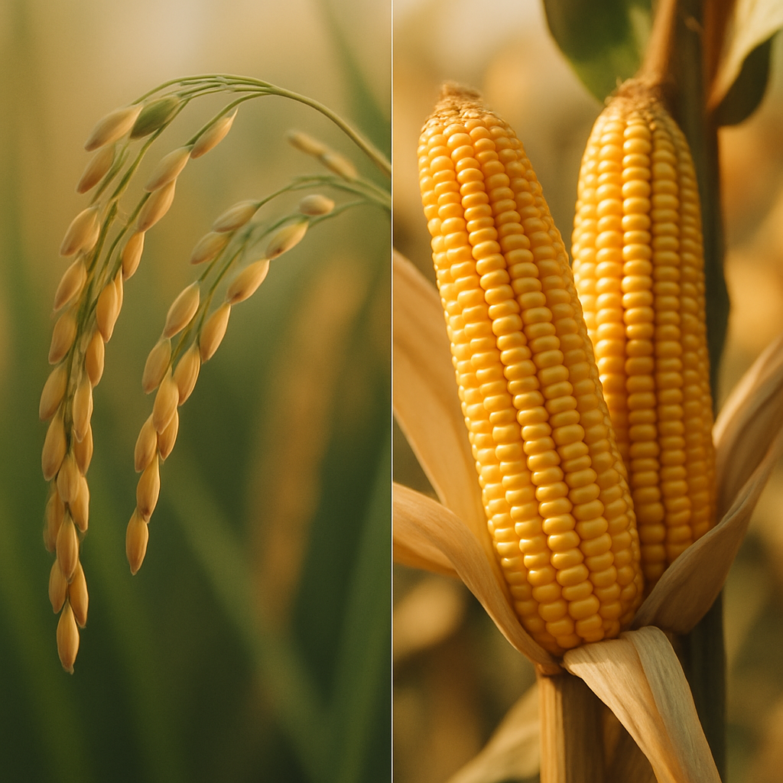
Problem Statement & Hypothesis
The Question
Can we predict which crop will maximize yield under a given combination of soil nutrients and climate conditions?
Our Hypothesis
If we know soil chemistry and climate variables, a Naïve Bayes classifier can identify the crop with the highest expected success probability.
Why it Matters
This project combines probability theory with data interpretation, two cornerstones of data science, to turn environmental data into practical, yield-oriented insights.
Can data decide what to plant?
For this proof of concept, we focused on two major crops, rice and maize, to demonstrate the method with a limited dataset before extending it to a larger, multi-crop dataset.
Notes:
Sahithi: We began with a focused question: given measurable soil and weather features, can Naïve Bayes help farmers choose the crop with the best yield potential? We’re testing that on rice and maize first; a controlled pilot for a broader system.
-maximize yield
-Soil chemistry and climate variables
-Highest expected success probability

Slide 5




Naïve Bayes Overview From ‘Play Tennis?’ to ‘Which Crop Yields More?’
PLAY TENNIS EXAMPLE
Weather Conditions
↓
Decision
CROP PREDICTION
Soil + Climate
↓
Crop Decision
Concept Conditions influence the chance of playing.
Feature List
☀️ Outlook 🌡️ Temperature 💧 Humidity 💨 Wind
Decision: Play/Don’t Play
Concept Soil and weather features influence optimal crop.
Feature List
🧪 Soil Chemistry (Nitrogen, Phosphorus, Potassium, pH) 🌡️ Temperature 💧 Humidity ☔ Rainfall
Decision: Rice/Maize
Notes:
Sahithi:
SIMPLE PROBABILY BASED CLASSIFIER
-predicts the highest probable outcome
- Assuming that all features are independent

Slide 6
Dataset Overview
We extracted a small subset of 15 samples: 9 for rice and 6 for maize, from a larger agricultural dataset.
Each sample captures seven environmental features matched to the optimal crop for those conditions: Nitrogen, Phosphorus, Potassium, Temperature, Humidity, pH, and rainfall.
These values are realistic — rice entries have higher humidity and rainfall, while maize rows represent moderate conditions.
This dataset is small enough to compute manually but still reflects real agricultural outcomes.
N | P | K | temperature | humidity | ph | rainfall | label
90 | 42 | 43 | 20.8797437 | 82.0027442 | 6.502985292000001 | 202.935536 | rice
85 | 58 | 41 | 21.7704617 | 80.3196441 | 7.03809636 | 226.655537 | rice
60 | 55 | 44 | 23.0044592 | 82.3207629 | 7.84020714 | 263.964248 | rice
74 | 35 | 40 | 26.4910964 | 80.1583626 | 6.98040091 | 242.864034 | rice
78 | 42 | 42 | 20.1301748 | 81.6048729 | 7.62847289 | 262.717341 | rice
69 | 37 | 42 | 23.0580487 | 83.3701177 | 7.0734535 | 251.055 | rice
69 | 55 | 38 | 22.708838 | 82.6394139 | 5.70080568 | 271.32486 | rice
94 | 53 | 40 | 20.2777436 | 82.8940862 | 5.718627177999999 | 241.974195 | rice
89 | 54 | 38 | 24.5158807 | 83.53521629999999 | 6.68534642 | 230.446236 | rice
71 | 54 | 16 | 22.6135995 | 63.6907056 | 5.7499144210000015 | 87.7595386 | maize
61 | 44 | 17 | 26.1001842 | 71.5747694 | 6.931756557999999 | 102.266245 | maize
80 | 43 | 16 | 23.5588209 | 71.5935137 | 6.65796475 | 66.7199547 | maize
73 | 58 | 21 | 19.9721595 | 57.6827292 | 6.59606065 | 60.6517148 | maize
61 | 38 | 20 | 18.4789126 | 62.6950387 | 5.97045843 | 65.4383539 | maize
68 | 41 | 16 | 21.7768932 | 57.8084064 | 6.15883062 | 102.086169 | maize
Notes:
Debasis: 1.Here’s the small dataset we used to train our Naive Bayes model. 2. We selected just 15 samples , 9 for Rice and 6 for Maize, taken from a larger agricultural dataset. From Kaggle. 3. Each row records seven key environmental features: Nitrogen, Phosphorus, Potassium, Temperature, Humidity, pH, and Rainfall. 4. The data is realistic: Rice entries naturally show higher humidity and rainfall, while Maize appears in more moderate conditions. 5. Using a small, interpretable dataset let us compute everything manually first, which helped verify our model’s logic before scaling it up.

Slide 7
Data Preprocessing: Feature Discretization
Key preprocessing step: feature discretization
To prepare the data for Naïve Bayes, we converted continuous features into categorical ranges.
Method:
We used tercile-based thresholds, dividing each continuous feature’s distribution into three equal-frequency groups.
Reasoning:
Naïve Bayes operates on categorical inputs, so discretizing the feature variables allows us to calculate conditional probabilities directly.
Example discretization:
Nitrogen: 90 → High Nitrogen
Temperature: 23ºC → Temperate
Rainfall: 250 mm → High Rainfall
Feature | 1st Tercile | 2nd Tercile | 3rd Tercile
N (Nitrogen) | Low | Med | High
P (Phosphorus) | Low | Med | High
K (Potassium) | Low | Med | High
Temperature | Cool | Temperate | Warm
Humidity | Low | Med | High
pH | Acidic | Neutral | Alkaline
Rainfall | Low | Med | High
Notes:
Debasis: 1.Since Naive Bayes works best with categorical data, we began by categorizing the continuous features. 2. Each numerical variable was grouped into three levels — low, medium, and high — using tercile-based thresholds. 3. For example, a Nitrogen value of 90 was categorized as High N, a temperature of 23 °C as Temperate, and rainfall around 250 mm as High Rainfall. 4. This process allowed us to calculate conditional probabilities more effectively. 5.It also made the model more straightforward — helping farmers interpret the results using familiar terms like High Rainfall, instead of raw numbers.

Slide 8
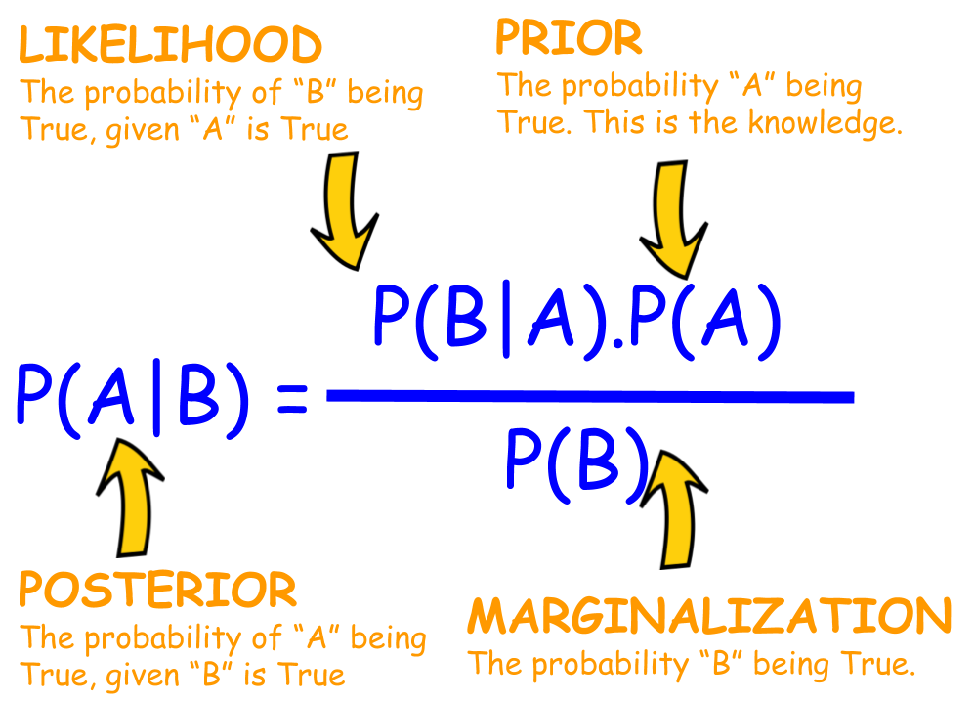
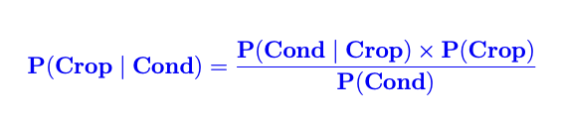
Mathematical Foundation: Bayes’ Theorem
Bayes’ Theorem powers our model to predict which crop best fits given environmental conditions.
It begins with prior knowledge — how each crop has performed historically.
Then, it considers new evidence — rainfall, temperature, and soil data.
The theorem updates our belief about each crop’s likelihood of success.
With every new observation, predictions become more accurate.
Thus, probability evolves into insight — turning data into smarter farming decisions.
Notes:
Debasis: 1. This slide connects the mathematical foundation behind the model. Bayes’ Theorem. 2. It combines prior knowledge, such as how each crop has performed in the past, with new evidence like current soil nutrients, temperature, humidity, and rainfall. 3. By updating these probabilities, the model continuously refines its understanding of which crop is most likely to perform best under present conditions. 4. In simple terms, Bayes’ Theorem turns probability into insight — helping us make smarter, data-driven crop decisions that evolve as new information becomes available.

Slide 9
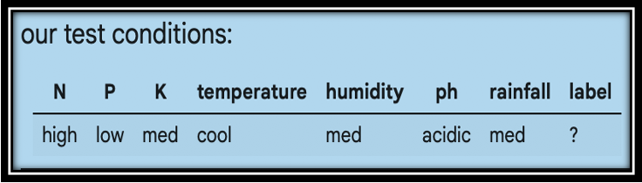
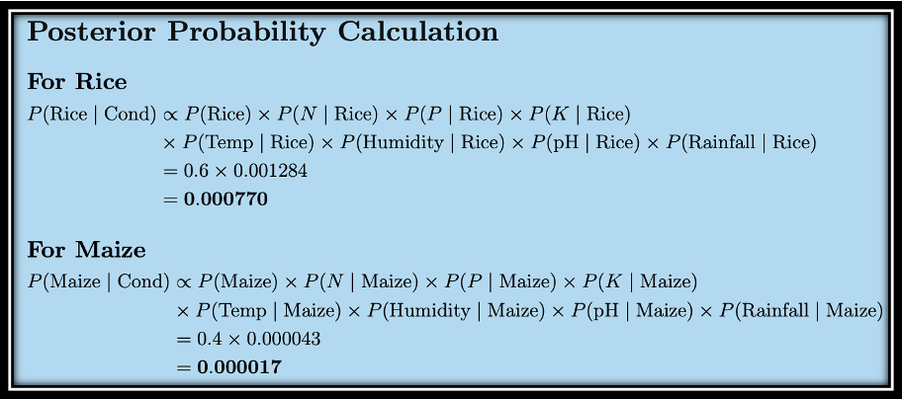
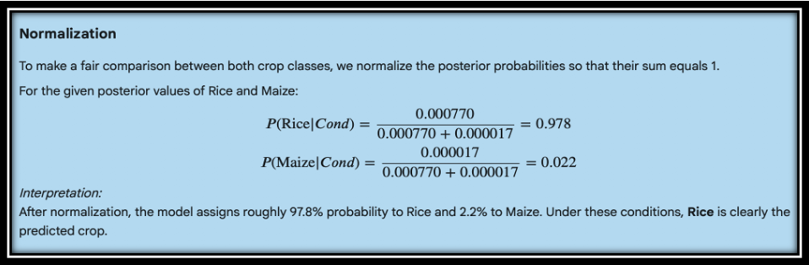
Posterior Probability Calculation
The posterior probabilities for both crops were computed using Bayes’ Theorem.
Each crop’s probability was determined by multiplying its prior with all conditional probabilities for the environmental features.
The calculations for Rice and Maize were performed separately, then normalized so the total probability = 1:
P(Rice | Cond) = 0.97
P(Maize | Cond) = 0.02
The model predicts Rice as the most suitable crop, with approximately 97 % probability under the given environmental conditions. 🌾
Notes:
Debasis: 1. Using Bayes’ Theorem, we computed the posterior probabilities for each crop. 2. Each probability equals the prior multiplied by all feature-wise conditionals. 3. After normalization so the total equals 1, we got: P(Rice | Cond) ≈ 0.97 and P(Maize | Cond) ≈ 0.02. 4. That means, under these environmental conditions, the model clearly favors Rice as the optimal crop. 5. This aligns perfectly with agricultural reasoning — Rice thrives in humid, high-rainfall zones, while Maize prefers moderate climates.

Slide 10
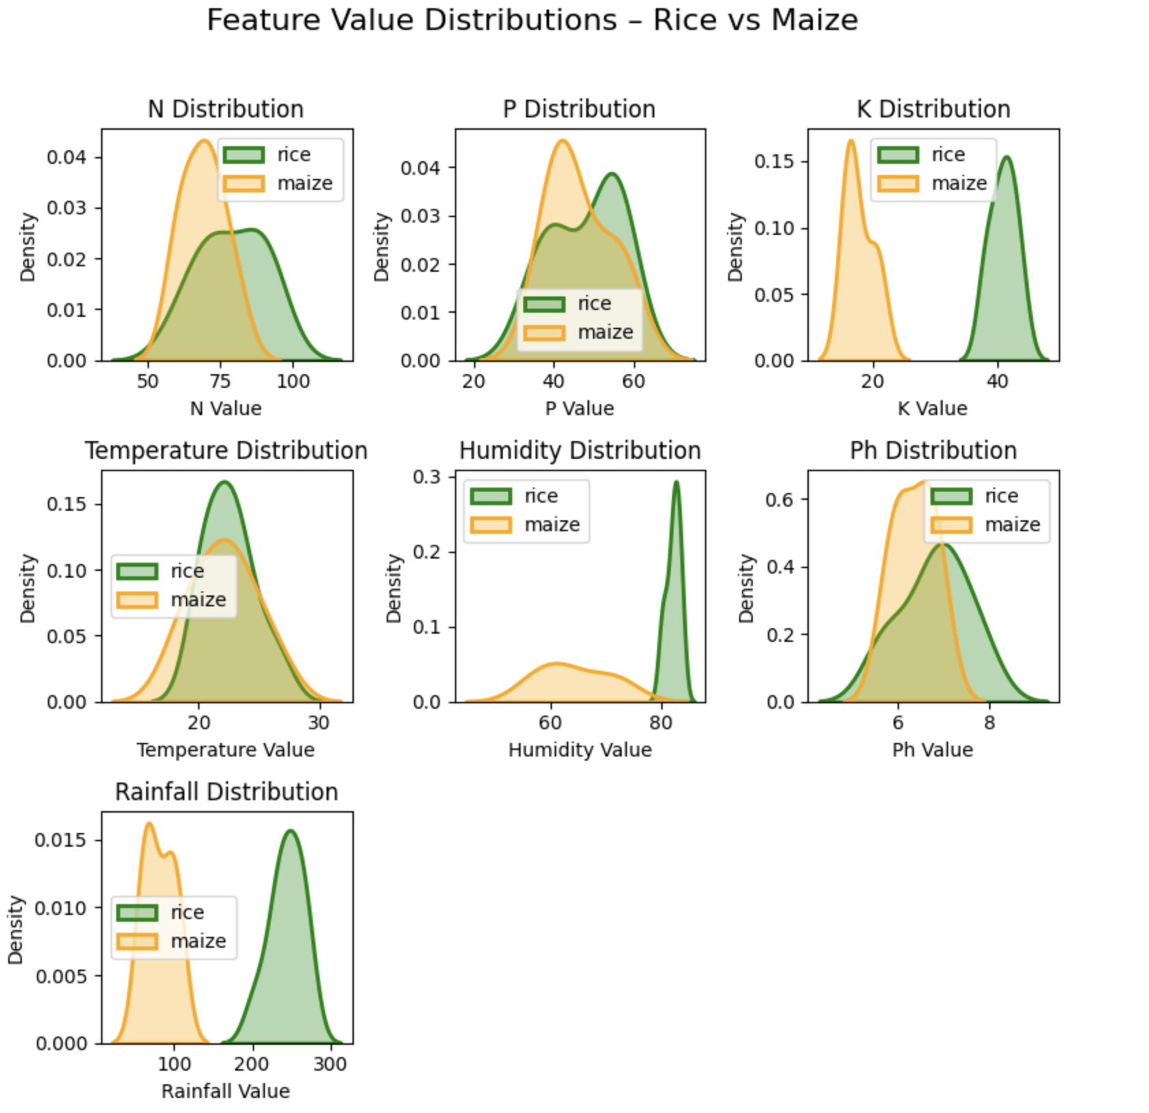
Visualization: Seeing the Data
After completing the calculations, we visualized the data to verify if it aligned with our probability results.
The rainfall distribution showed Rice thriving in higher rainfall zones, while Maize dominated moderate regions.
Likewise, Rice correlated with higher humidity, whereas Maize preferred slightly acidic pH conditions.
These visual patterns validated that our dataset and model were in strong agreement.
Notes:
Debasis: 1. Finally, we visualized the dataset to check that the model’s logic matches the actual data. 2. The plots show Rice dominating higher rainfall and humidity regions, while Maize appears in lower-rainfall, slightly acidic areas. 3. These visual patterns validate that our dataset and probability model agree closely. 4. It’s a good reminder that in machine learning, visual checks often confirm whether the math truly reflects real-world behavior.

Slide 11
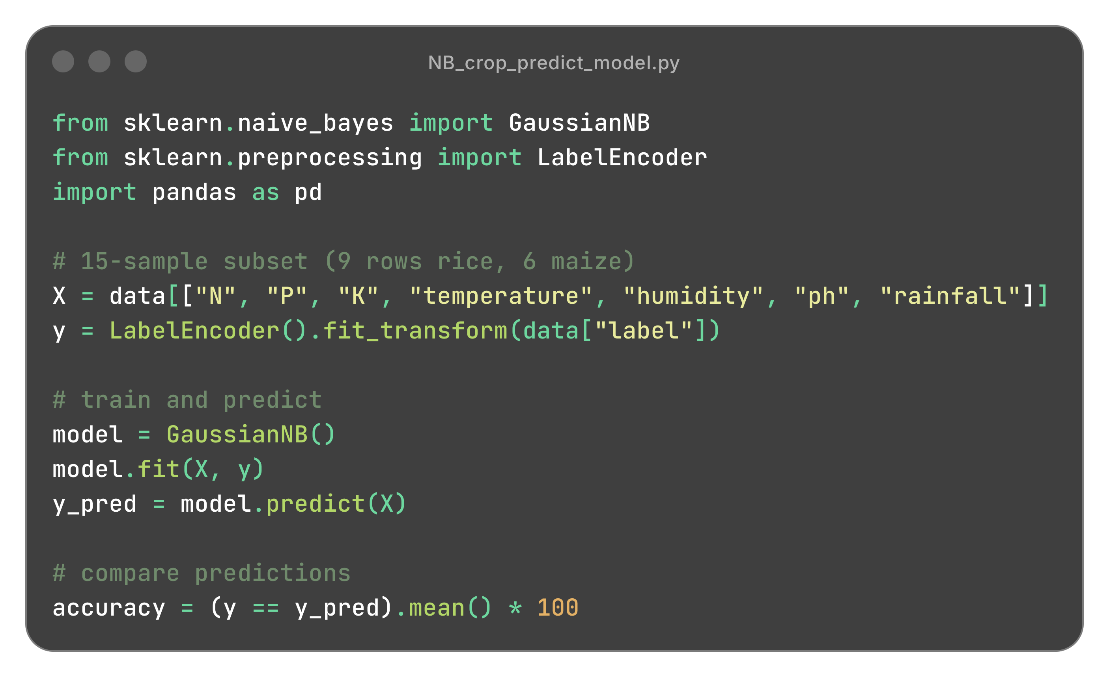
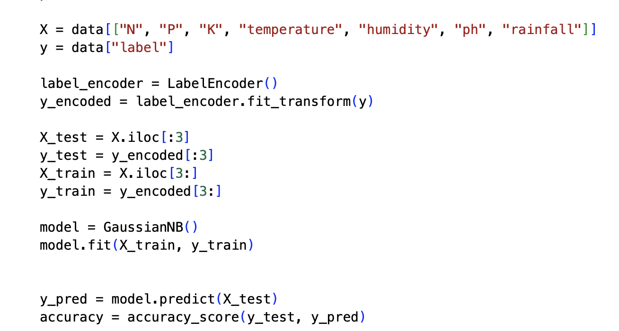
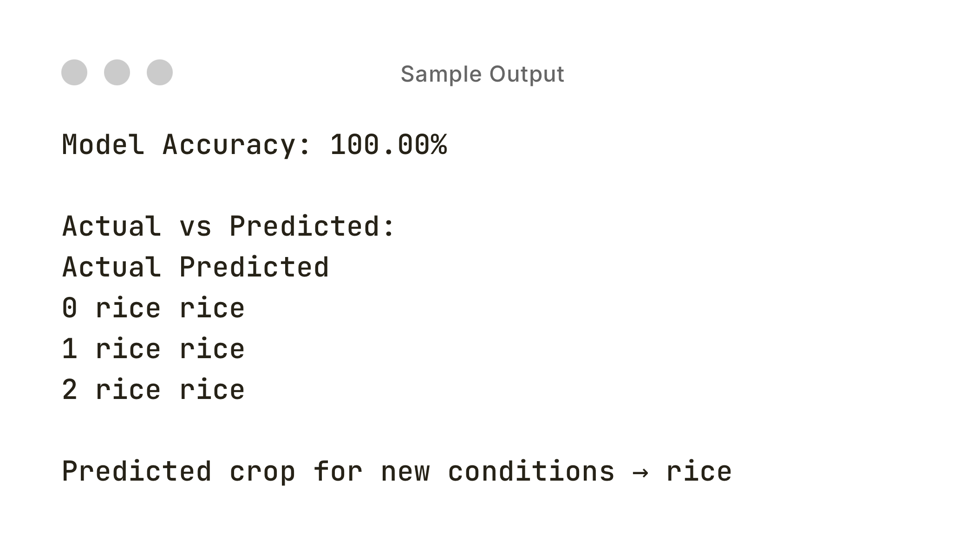
Implementation in Python
Implemented a Naïve Bayes classifier using GaussianNB from scikit-learn
Followed a standard data-science workflow: data preparation → encoding → training → prediction
Used the same 15-sample dataset as in the manual example (9 rice, 6 maize)
7 Input features:
N, P, K, temperature, humidity, pH, and rainfall
Crop labels were numerically encoded for model compatibility
The model produced identical predictions to manual calculation, confirming the logic translated correctly into code
Notes:
Noah: Once we had the math working by hand, we built the same thing in Python.
We used the exact same data: fifteen samples, nine rice, six maize.
And when we ran it… the model gave identical results.
Every prediction matched perfectly.
That’s how we knew the logic worked.

Slide 12
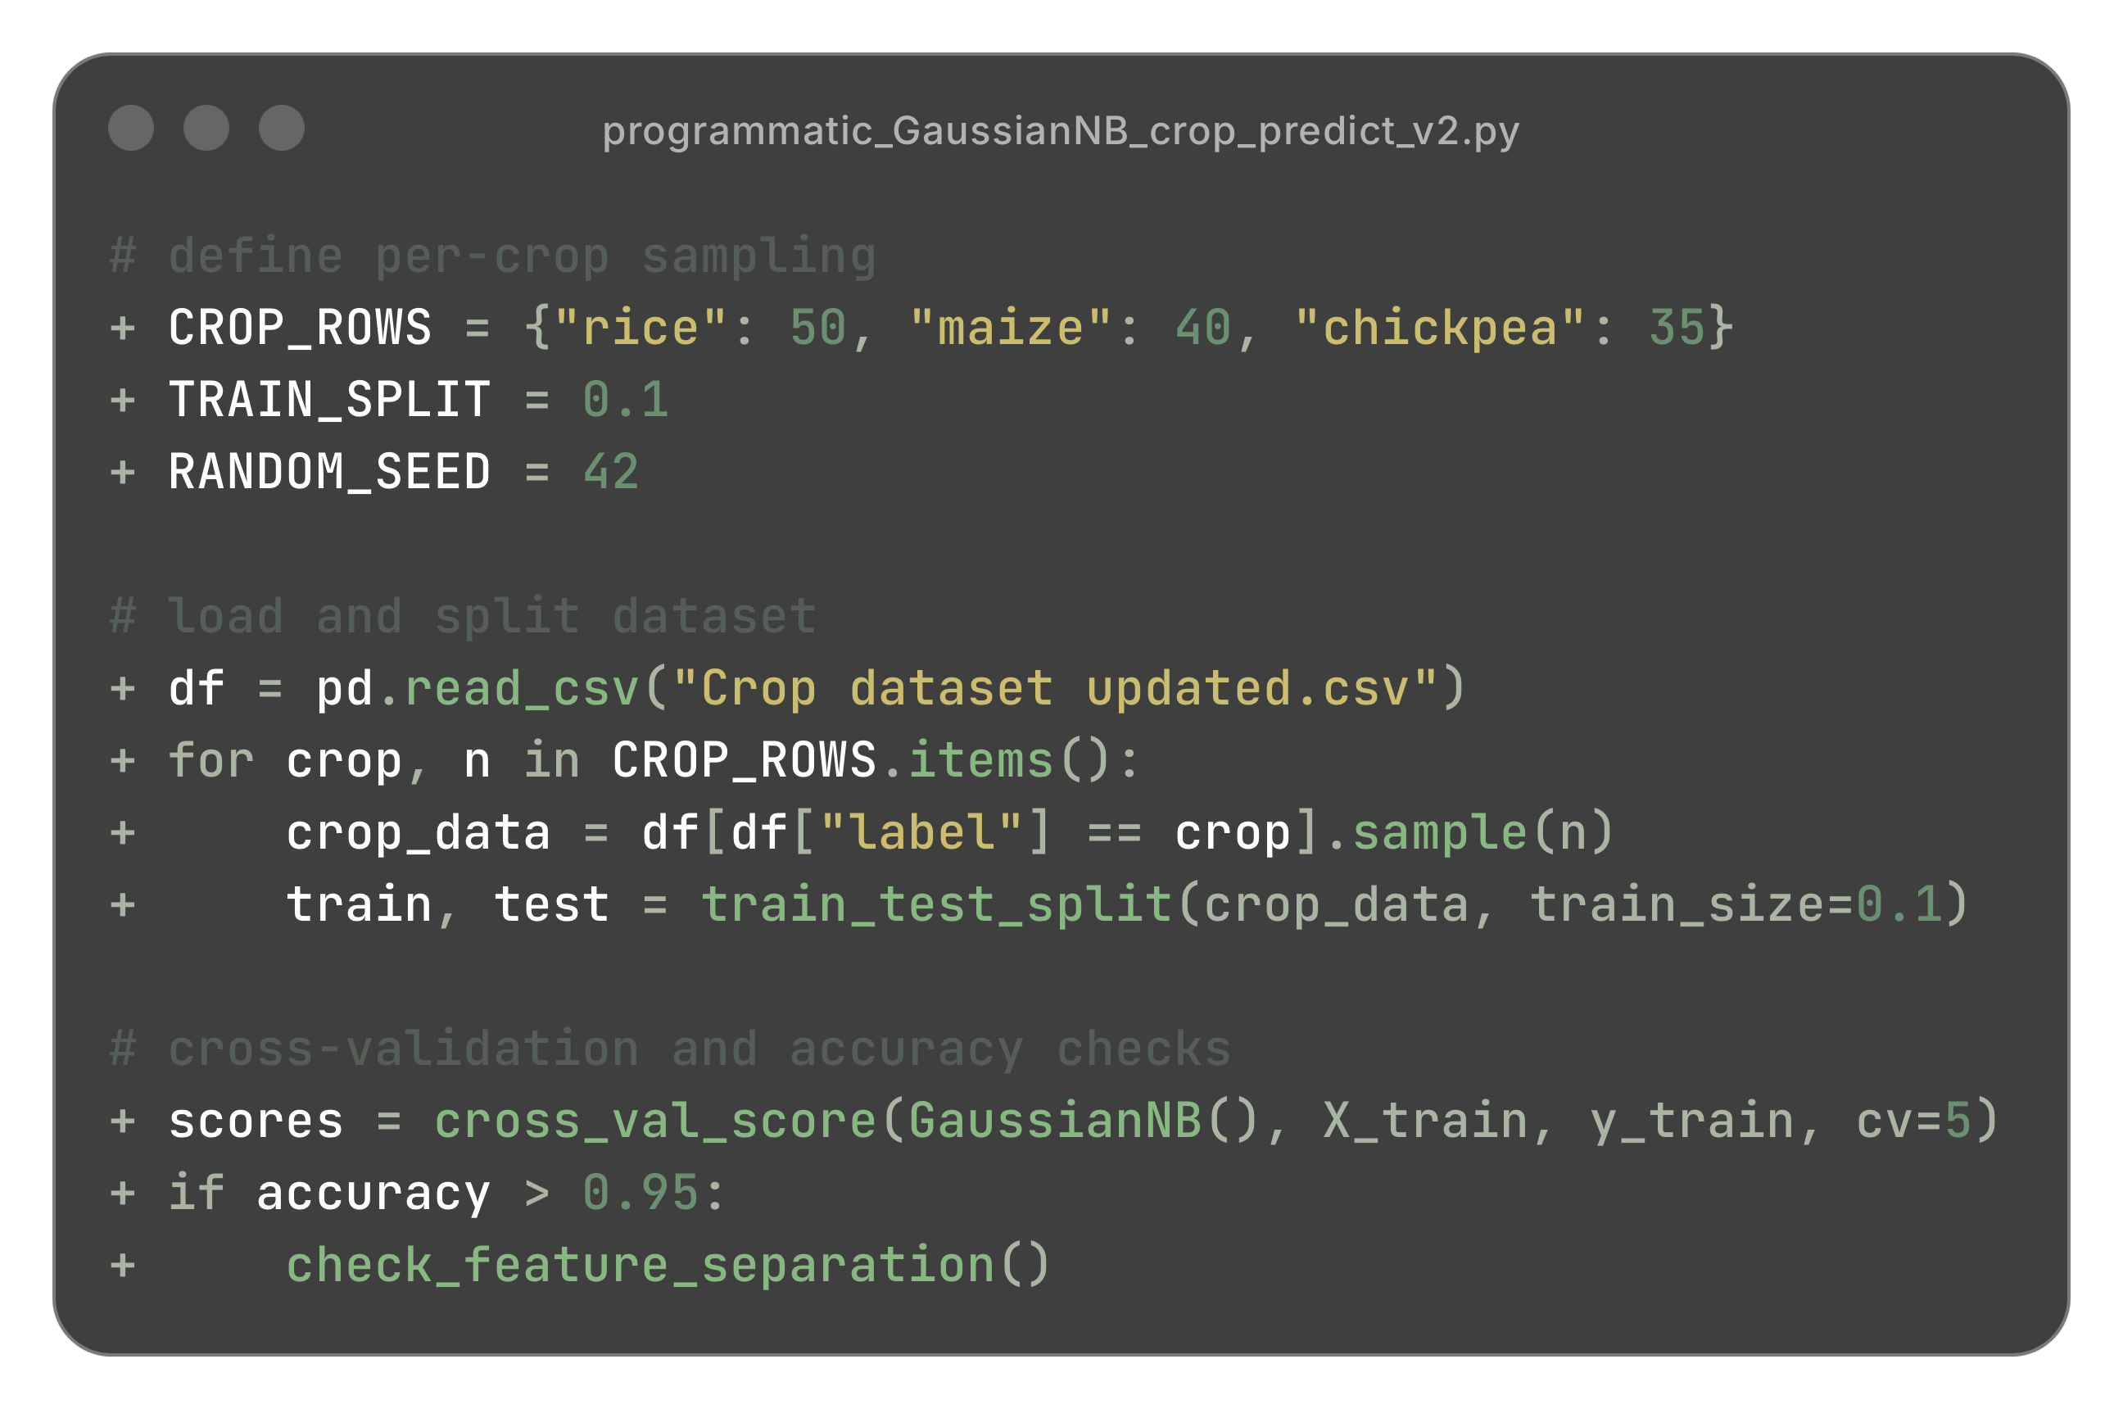
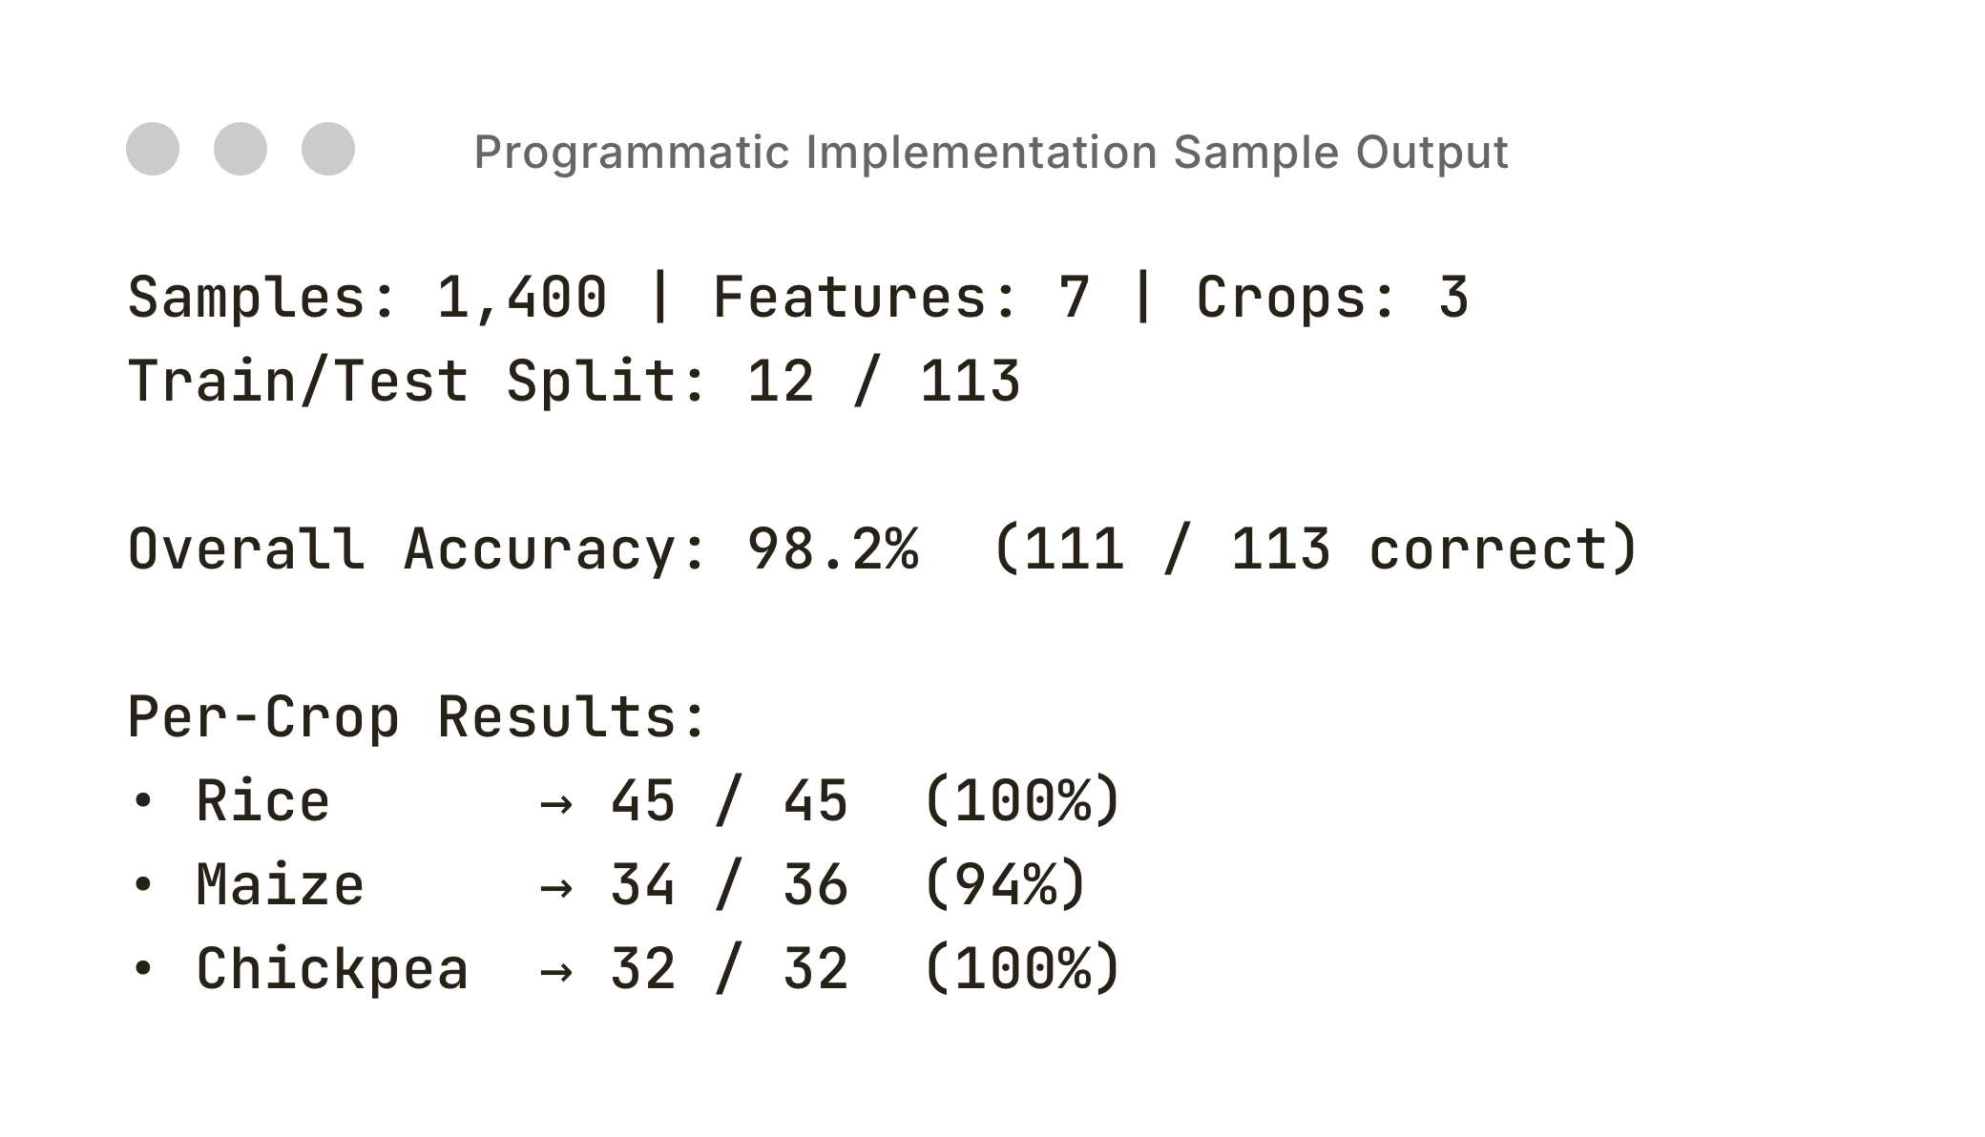
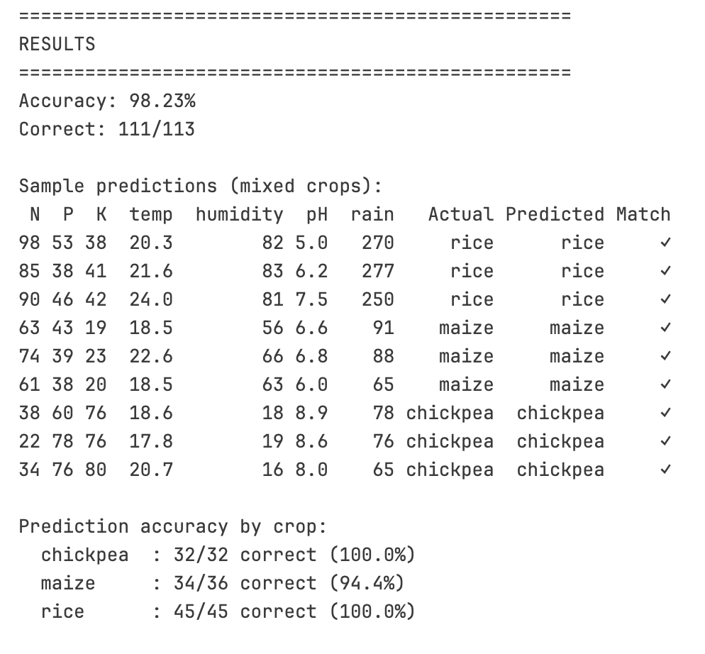
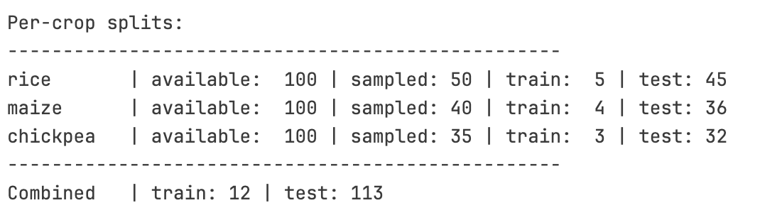
Scaling and Testing the Model
Implementation in Python
Python: using pandas and GaussianNB to extend the 15-row prototype into a fully scalable model.
We scaled from a 15-row subset to a full 1,400-sample dataset to see how a programmatic version of our model performed under broader, more realistic conditions.
Goal: explore how model accuracy changed (or stubbornly refused to change) as we scaled data and shifted its composition.
Experimental Variables:
Rows per crop: 5-100
Number of crops: 2-14
Train/test splits: 10%-90%
Purpose:
To understand whether scaling the dataset revealed genuine learning behavior or if accuracy stayed unrealistically high due to clean data.
Example Case:
3 crops
12 training samples
113 test samples
Even with minimal training data and added crops, accuracy barely dropped.
Implemented using pandas for data handling, and scikit-learn GaussianNB()
We expanded from the 15-row subset to the full 1,400-sample dataset to see how a more programmatic implementation of the model performs under larger and more diverse conditions 14 crops,100 samples: 1,400 total rows
Observe how the model would behave under larger, more diverse conditions
Understand whether scaling would make the model more realistic or reveal new limitations.
Data Processing: Used pandas to load and manage crop dataset (1400 samples, 7 features)
Model: Gaussian Naive Bayes classifier from sklearn
Features: 7 soil/environmental features (N, P, K, temperature, humidity, pH, rainfall)
Model Results:
Model Inputs:
Notes:
Noah: Once we saw the model worked… we wanted to push it.
What happens when we scale it up: when we feed it more data, more crops, more complexity?
We built a version that could handle the entire dataset: fourteen crops, fourteen hundred samples.
And here’s what happened.
Even with almost no training data, twelve samples total, the accuracy barely changed.
Ninety-eight percent.
It just… refused to fail.
And that’s when we realized maybe the problem wasn’t the model.
Maybe it was the data.

Slide 13
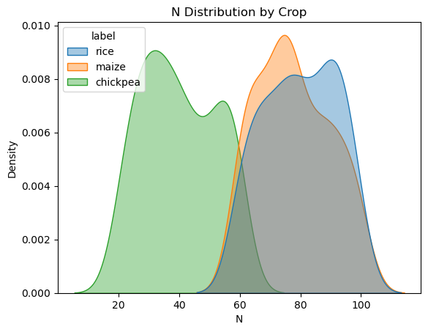
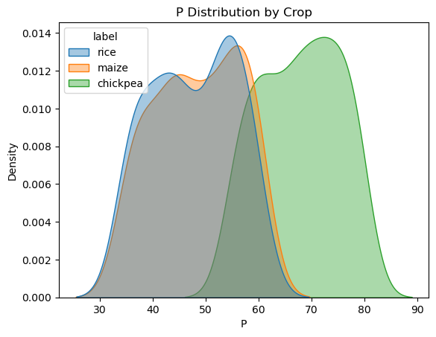
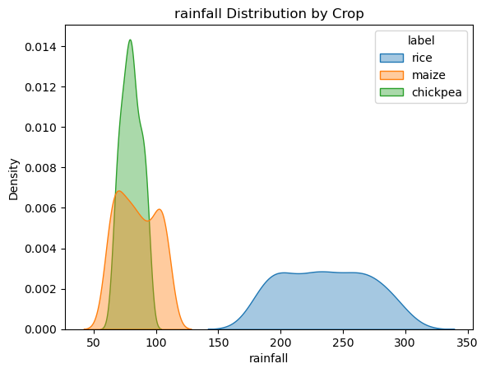
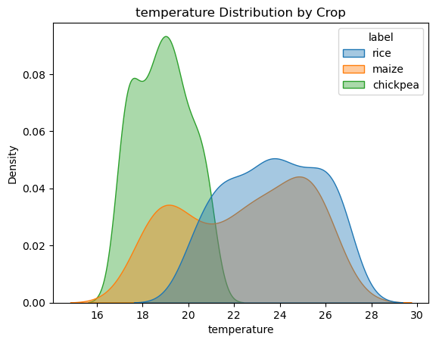
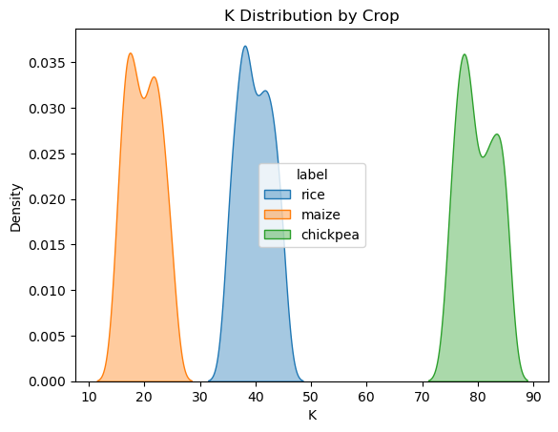
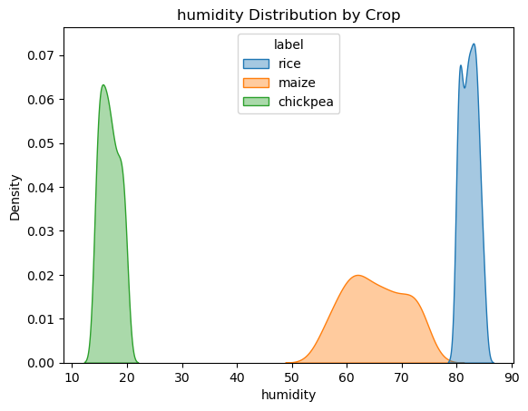
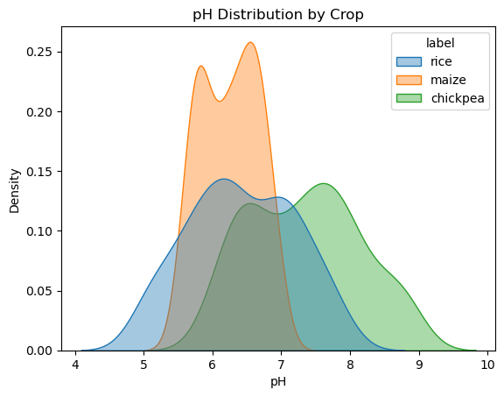
Data Visualization
Implementation in Python
To understand why accuracy remained so high, we visualized feature distributions across crops.
These plots show that crop classes are almost perfectly separated, especially by Potassium (K):
The K (Potassium) feature alone nearly predicts the crop identity.
In many cases, each crop occupies a distinct region of feature space
This explains the model’s near-perfect accuracy: it didn’t need to “learn,” just recognize clean boundaries.
Real agricultural data would have overlapping nutrient ranges and noise, which would lower accuracy to realistic levels
Notes:
Noah: After scaling the model, accuracy stayed almost perfect, even with way fewer training samples.
So, we plotted the data to see why.
Turns out, the crops are almost perfectly separated.
Each sits in its own zone, and Potassium alone basically predicts the crop.
So, the model wasn’t really learning, it was just spotting clean boundaries.
In real-world data, those overlaps would bring accuracy closer to 70–80%.
In the end, that near-perfect score told us more about how clean the dataset was than how smart the model was.

Slide 14

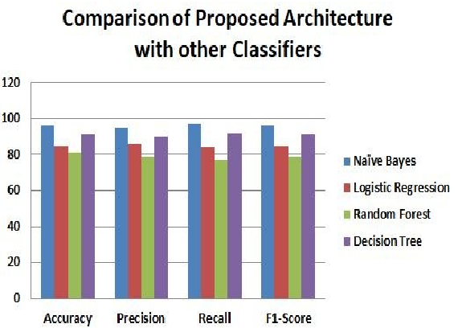


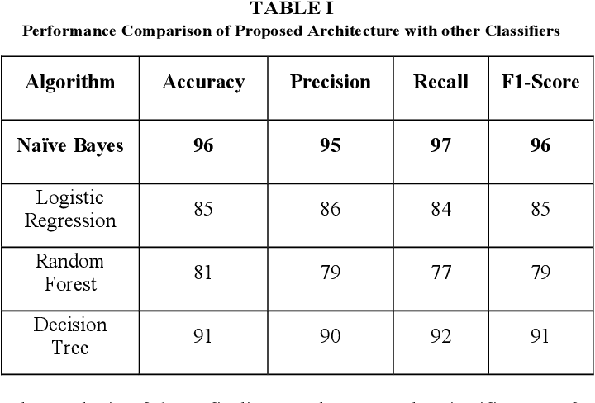

Related Work
“Development of a Naive Bayes-based Framework for Optimizing Crop Recommendation System and Enhancing Agricultural Yield Prediction”
Naïve Bayes, Logistic Regression, Decision Tree, Random Forest
Used similar dataset with soil nutrients and environmental factors
Calculated priors, likelihoods and posterior probability
”most effective for accurately predicting suitable crop options based on a range of key parameters"
"most effective due to its simplicity, efficiency, and robust performance with large datasets."
Notes:
Sahithi:
MULTIPLE ALGORITHM APPROACH
ability to handle numerous variables
even in noisy environments
an optimal
can significantly impact crop performance and productivity.
a = What percentage of total predictions were correct.
P = When the model predicts positive, how often is it correct?
Measures quality of positive predictions.
R = Out of all actual positives, how many did the model correctly detect?

Slide 15
Conclusion
Hypothesis: The Naïve Bayes model can accurately predict the crop using the soil nutrient data and environmental conditions.
It is simple, fast, and interpretable
Next steps:
Larger dataset with live data
Additional features and data from other regions
"Future work could further augment the model's accuracy by incorporating real-time sensor data and considering economic factors, providing farmers with even more precise and actionable insights to improve productivity and reduce resource waste."
Notes:
Sahithi:

Slide 16
Citations
P. Swetha and J. Senthilkumar, "Development of a Naive Bayes-based Framework for Optimizing Crop Recommendation System and Enhancing Agricultural Yield Prediction," 2025 4th International Conference on Sentiment Analysis and Deep Learning (ICSADL), Bhimdatta, Nepal, 2025, pp. 1262-1267, doi: 10.1109/ICSADL65848.2025.10933086.
Notes:
Sahithi::

